Slide 1
IEEE 754 Floating Point Numbers
Operations

Slide 2
Representable Numbers
IEEE 754 specifies three types of floating-point numbers:
Single ( Fortran's REAL*4, C's float )
Double ( Fortran's REAL*8, C's double )
Double-Extended ( Fortran REAL*10+, C's long double )
There’s a fourth quadruple precision format that is not specified by IEEE 754. It is not fully supported in hardware, so it runs rather slowly.

Slide 3
Format
An IEEE 754 format is a "set of representations of numerical values and symbols”.
An IEEE format consists of:
finite numbers (either binary or decimal),
two infinites (+/-∞) – when a nonzero number is divided by zero,
and two kinds of NaN: a quiet NaN – qNaN and a signaling NaN (sNaN).
NaN means something has gone wrong with the computation.

Slide 4
Finite Numbers
May be either base 2 (binary) or base 10 (decimal).
Each finite number is described by three integers: s = a sign (zero or one), c = a significand (or 'coefficient'), and q = an exponent.
(−1)s × c × bq where b is the base (2 or 10). For example, if the sign is 1 (indicating negative), the significand is 12345, the exponent is −3, and the base is 10, then the value of the number is −12.345

Slide 5
Differences between quiet NaN and signaling NaN
A quiet NaN:
- a NaN that has a one as the most signifcant bit of its signifcand.
Examples: dividing zero by another zero, trying to take a square root of a negative number
A quiet NaN, when used as an operand, quietly produces another quiet NaN as its
output. The end result (or some print statement printing an intermediate value) shows
that it is a NaN, and the programmer systemetically works backwards to identify the
operation that produced the rst quiet NaN and x the bug. This scheme of doing things
does not require the ow of control to be disrupted abruptly.
A signaling NaN:
a NaN that has a zero as the most signifcant bit of its significand.
The sign of a NaN has no meaning, but it may be predictable in some circumstances.

Slide 6
Zeroes
Zero values are finite values with significand (coefficient) 0. These are signed zeros, the sign bit specifies if a zero is +0 (positive zero) or −0 (negative zero).
The value zero in the real form may be signed either positive or negative. A bit pattern with all zeroes is called a clean zero.

Slide 7
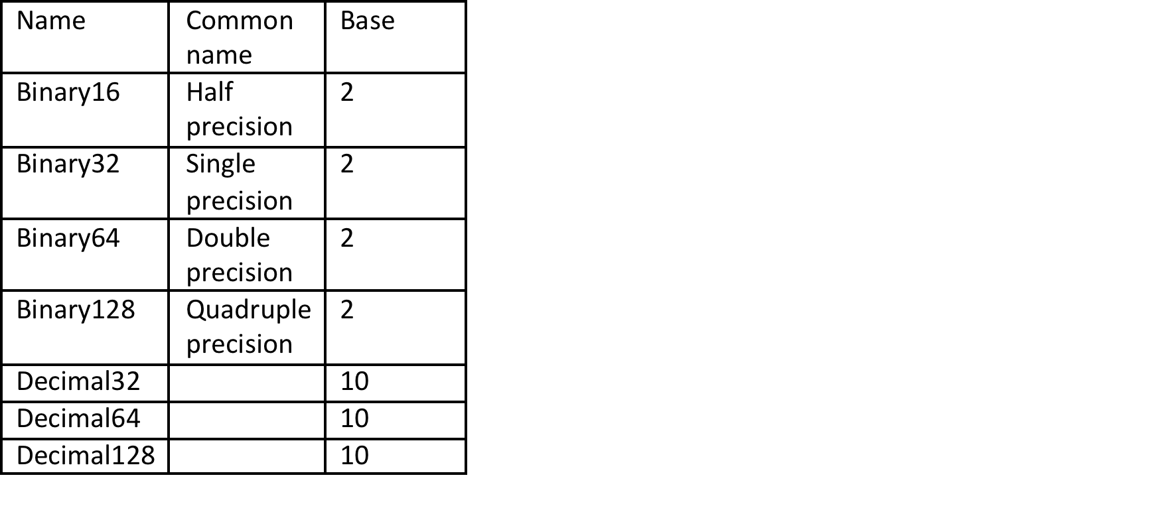
Basic Format
5 basic formats:
three binary floating-point and two decimal floating point basic formats
The standard defines five basic formats that are named for their numeric base and the number of bits used in their interchange encoding. There are three binary floating-point basic formats (encoded with 32, 64 or 128 bits) and two decimal floating-point basic formats (encoded with 64 or 128 bits). The binary32 and binary64 formats are the single and double formats of IEEE 754-1985.
*Must implement at least one of the basic formats!

Slide 8
Other Formats
The IEEE 754 standard specifies extended and extendable precision formats, which provide a greater precision than the basic formats.
Extended precision format – allows user to specify the precision and exponent range
The possible finite values that can be represented in a format are determined by the base (b), the number of digits in the significand (precision, p), and the exponent parameter emax.
These parameters uniquely describe the set of finite numbers (combinations of sign, significand, and exponent for the given radix) that it can represent.
The standard does not require an implementation to support extended or extendable precision formats.

Slide 9
Extended and extendable precision formats
Extension of basic format
Allows user to specify the precision and exponent range.
Parameters for representing finite values:
base (b)
the number of digits in the significand (precision, p), and
the exponent parameter emax.
These parameters uniquely describe the set of finite numbers that it can represent.
The standard does not require an implementation to support extended or extendable precision formats

Slide 10
Interchange Formats
Meant for the exchange of floating-point data using a fixed-length bit-string for a given format.
The 16-bit format is intended for the exchange or storage of small numbers (e.g., for graphics).
Some flexibility in the encoding of signaling NaN.
For the exchange of decimal floating-point numbers, interchange formats of any multiple of 32 bits are defined.
The encoding scheme for the decimal interchange formats similarly encodes the sign, exponent, and significand

Slide 11
Addition/Subtraction
1. Determine which number is larger
2. Shift the mantissa of the smaller number right until it’s exponent matches the exponent of the larger number
3. perform binary addition/subtraction on the two mantissas

Slide 12
Multiplication
1. If either number is zero give zero
2. Csign = Asign XOR Bsign
3. Cexpononent = Aexponent + Bexponent – 127
4. Cmantissa = Amantissa *Bmantissa

Slide 13
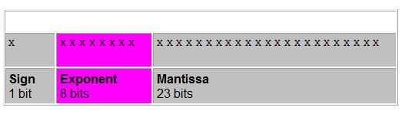
IEEE Floating Point Number Single Precision rounding
Source: http://www.cs.duke.edu/~raw/cps104/TWFNotes/floating.html
The first sign bit represents the sign of the number (either a 1 or a 0).
The next 8 bits determine the exponent stored in biased 127 (single precision) form, meaning it needs to represent both positive and negative exponents. That’s where the bias comes into play. The bias gets the stored exponent.
The last 23 bits will carry the mantissa normalized to be between 1 (less than or equal) and less then 2.
(Mantissa: is the number of digits. Always starts with a non-zero digit.)
With mantissa we have to limit the bits.

Slide 14
Conversion
To convert an integer: first convert the integer part of the number generate the binary equivalent. Then convert the fractional part and generate the binary fraction, place together and normalize.
Truncation versus Rounding
Truncation: limits the no. of digits to the right of the decimal point and discard the least significant ones. Disadvantage is it undervalues the result and can cause Truncation error.
Rounding: If a lost digit is greater than a half 1 will be added to the least significant bit to round up. With rounding we have more accuracy and end up with fair error. But it requires up to two further arithmetic operations.
Otherwise we just leave as is and round down.

Slide 15
IEEE 754 Exception Handling
There are five exceptions that are part of the floating point standard

Slide 16
INVALID operation exception
An INVALID flag is raised when an operations operands lie outside of its domain.
The operations that trigger INVALID are real√(negative), 0-∞, 0.0/0.0, ∞/∞, REMAINDER(Anything,0.0), REMAINDER(∞, Anything), ∞-∞(when signs agree).
∞+∞ = ∞ and would not throw exception
Conversions to other formats can raise and INVALID if the limits are violated.
The default for these situations is to issue NaN(not a number)

Slide 17
DIVIDE BY ZERO exception
Since zero is replaced by ∞, this exception could be reworded as “infinite results computed exactly from finite operands”.
When this exception is active, and all goes as it should, a division by zero occurs, infinite intermediate results will yield finite final results.
If all does not go as it should, infinity will turn into NaN and trigger INVALID.

Slide 18
OVERFLOW exception
When the result of a computation is outside of the range of the floating point format destination.
Default for this exception is to approximate the result with a appropriately signed ∞.
Approximations often make calculations worthless, and more prone to throwing more exceptions or giving an incorrect value.
Can also throw INEXACT exception, or can turn into NaN.
When OVERFLOW trap is enabled, the Default ∞ is not generated. The results exponent is “wrapped”, so the delivered result has an exponent too small by 2^(k-1) *3 (for single precision is 2^192 or 6.3e57), so the result turns into a very small, but predictable number that the trap-handler can interpret.
In other words. If overflow occurs with the trap enabled, it takes the result and divides by 6.3e57.

Slide 19
UNDERFLOW exception
When a nonzero result is computed that lies closer to zero than the standards “normal” positive number nearest zero. Numbers smaller than 6.3e-57 would throw this exception.
Numbers smaller than that must be rounded to the nearest subnormal number.
Subnormal numbers can yield very small numbers by taking 1x10^-100 and changing it to .1x10^-100.
Subnormal numbers (also known as Denormalized) allow underflow to occur gradually.
When the trap is enabled, the result is “wrapped” to make it big, but predictable number that the trap-handler can interpret.

Slide 20
Exponent Wrapping
Best way to compute extended products and quotients like:
(a1+b1)*(a2+b2)*(an+bn)
Q=--------------------------------
(c1+d1)*(c2+d2)*(cm+dm)
When n and m are huge and when the numerator/denominator are likely to encounter premature OVER/UNDERFLOW even though Q would not throw an exception if it were computed.
Q requires a trap-handler that counts OVER/UNDERFLOW but leaves exponents unchanged and separately computes the numerator and denominator.
The numbers will have the right amount of significant bits, which, if wrong, can be corrected by taking counts into account.

Slide 21
INEXACT exception
Signaled when ideal result of an operation will not fit into the destination, so the answer must be rounded to fit. This exception is disabled by most floating point software.

